Slide 1
Grid Chat

Slide 2
Twist Boundary
Tilt Boundary
Diffraction
Conditions
D= 3 nm
Relaxation
Time
D= 3 nm
Relaxation
Time
D= 1 nm
Notes:
Twist boundaries have same behavior as tilt boundaries. But, the magnitude of their scattering potential is smaller.
Observed turnover even without rotation term
Get turn over with or without rotation??

Slide 3
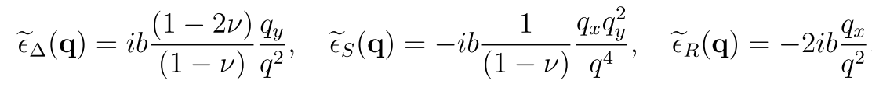
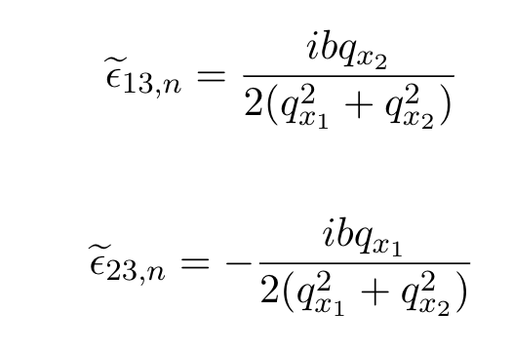
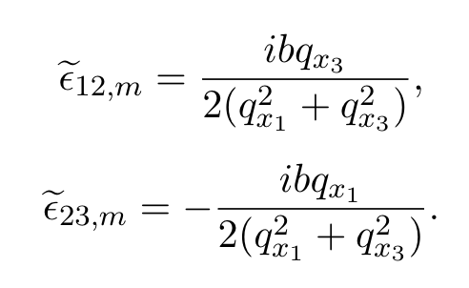
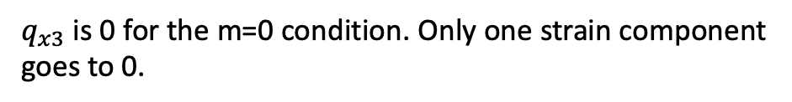
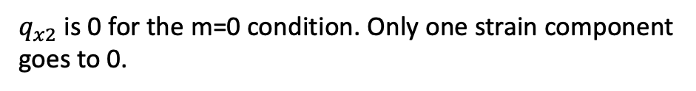
Twist Boundary: m=0 conditions
Tilt Boundary:
$q_{y}$ is 0 for the m=0 condition. Therefore, the only non-zero term comes from rotation, and without rotation the relaxation time would diverge
Twist Boundary:
N-array:
(b in z, spaced in y)
M-array:
(b in y, spaced in z)
$q_{x2}$ is 0 for the m=0 condition. Only one strain component goes to 0.
$q_{x3}$ is 0 for the m=0 condition. Only one strain component goes to 0.
Notes:
Twist boundaries have same behavior as tilt boundaries. But, the magnitude of their scattering potential is smaller.
PLOT the strain fields!!
Get turn over with or without rotation??

Slide 4
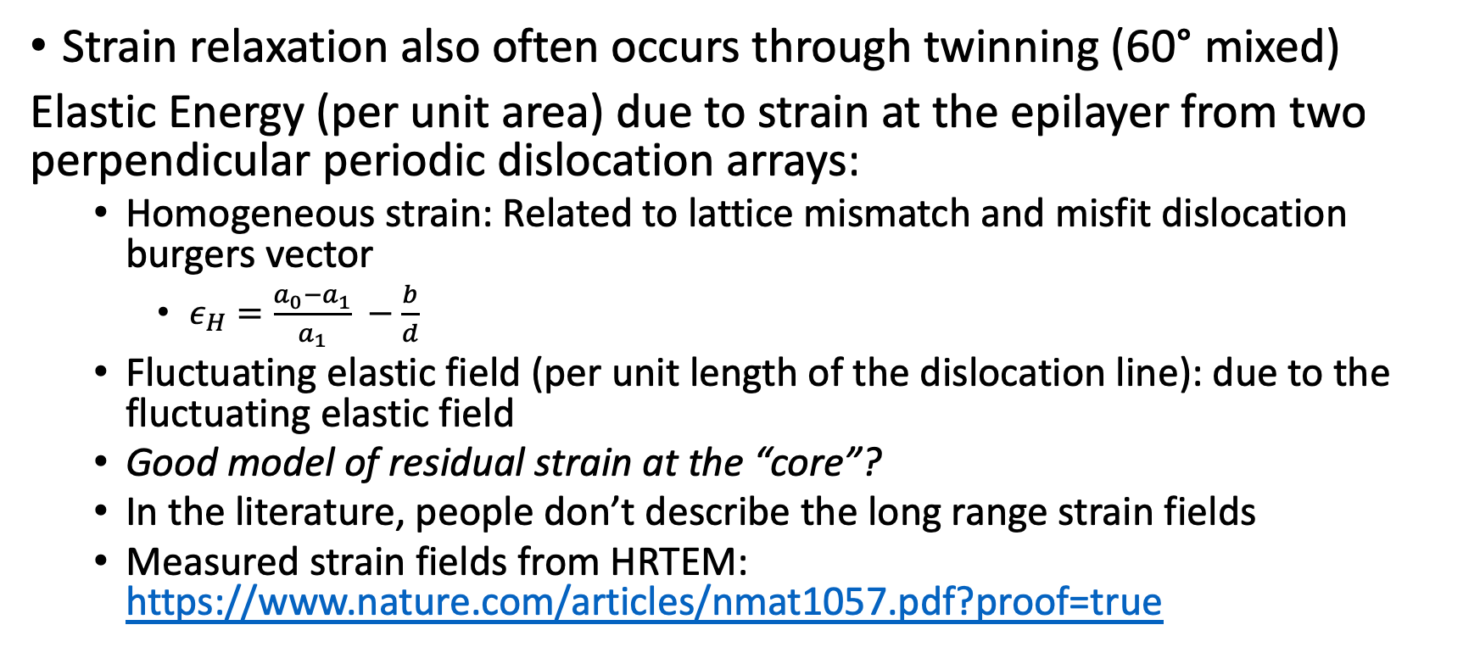
Heterointerfaces Boundaries
Strain relaxation also often occurs through twinning (60° mixed)
Elastic Energy (per unit area) due to strain at the epilayer from two perpendicular periodic dislocation arrays:
Homogeneous strain: Related to lattice mismatch and misfit dislocation burgers vector
$ε_{H}=\frac{a_{0}−a_{1}}{a_{1}} −\frac{b}{d}$
Fluctuating elastic field (per unit length of the dislocation line): due to the fluctuating elastic field
Good model of residual strain at the “core”?
In the literature, people don’t describe the long range strain fields
Measured strain fields from HRTEM: https://www.nature.com/articles/nmat1057.pdf?proof=true

Slide 5
Van der Merwe Strain fields
Notes:
Treating a single array. “Plane strain” problem.
What’s up with the colorbars?

Slide 6
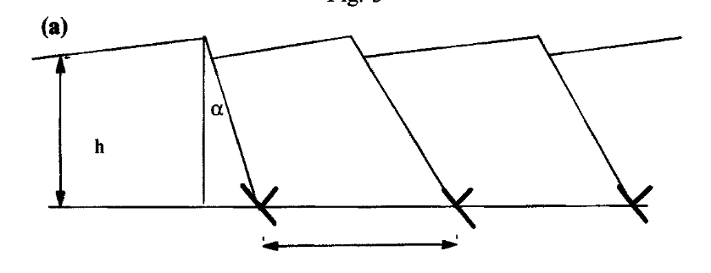
Twins Schematic

